Slide 1
Course code: CSD342 course title: Data Mining and Data Warehousing course Instructor: Dr. Dolly Sharma

Slide 2
School | SOE
Department | Computer Science and Engineering
Course Code | CSD342
Course Title | Data Mining and Data Warehousing
Credits (L:T:P) | 2:0:1
Contact Hours (L:T:P)* | 2:0:2
Prerequisites | CSD209, CSD202
Major Core for** | NA
Major Elective for | CSE

Slide 3
Course Summary
In this course, we would explore the fundamental data mining methodology, OLTP and OLAP, data pre-processing, association rules mining, clustering, classification, and other advanced topics in the field such as Social impact of Data mining, Recent trends in Data mining research, Challenges and Future Scope, need for Security and Privacy preserving in Data Mining

Slide 4
Course Aims
The aim of the course is as follows:
To provide students with fundamental knowledge of data mining process.
To enable students to apply association rules, classification and clustering on datasets.
To develop students’ skills in understanding certain real-world data mining tasks, and then appraise and evaluate solutions.

Slide 5
Learning Outcomes
On successful completion of the course, students will be able to:
Demonstrate a comprehensive understanding of different tasks associated in Data Warehousing and Data Mining.
Understand the concepts of Data Pre-processing in the Data Mining process.
Understand concepts of Association rules mining.
Understand concepts of Data Mining techniques, such as Clustering, Classification, etc.
Formulate and Design solutions for real-world Data Mining applications and Implement the designed solutions in the most suitable programming language.
Evaluate and Appraise/Criticize the solution designed for any data mining task.

Slide 6
Curriculum content
Introduction to data mining
Introduction to data warehousing, Modern Data Warehouses
Data Preparation - Feature extraction, Data Cleaning, Reduction and Transformation, Data Visualization
Mining Association Rules, From Association Mining to Correlation Analysis
Clustering and Classification, Outlier Analysis Mining Text Data
Mining Time-series data Spatial data mining
Mining Biological data
Security and Privacy preserving in Data Mining

Slide 7
Assessment Strategy
Evaluation Instrument | Weightage | Time | Comment
Midterm Exam | 15% | 1.5 hours | Closed Book, In Class
Laboratory/Programming Assignments/ Project | 40% | By due date and time | Programming assignments to be finished by due date.
Quiz | 20% | -- | In-class Quiz
Final Exam | 25% | 2 hours | Closed Book, In Class (Comprehensive Exam of complete syllabus)

Slide 8
Bibliography
S.No. | Title | Author | ISBN No. | Publisher
1 | Data Mining: Concepts and Techniques | J. Han and M. Kamber | 9789380931913 | Elsevier
2 | Mining Massive Datasets | J. Lescovek,A. Rajaraman | 1316638499 | Dreamtech Press
3 | Data Mining: The Textbook | Charu C. Agarwal | 3319381164 | Springer
4 | Applied Machine Learning | M. Gopal | 9353160251 | McGraw Hill Education

Slide 9
We are living in the Information age
Are we really?
Well, we are actually living in a data age.
This explosive growth of available data volume is a result of the computerization of our society and the fast development of powerful data collection and storage tools.
Powerful and versatile tools are needed to automatically uncover valuable information from the tremendous amounts of data and to transform such data into organized knowledge. This necessity has led to the birth of data mining.

Slide 10
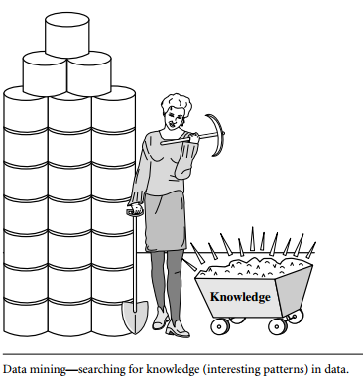
What is Data Mining?
Data mining is the process of discovering interesting patterns (or knowledge) from large amounts of data.
Many other terms have a similar meaning to data mining—for example, knowledge mining from data, knowledge extraction, data/pattern analysis, data archaeology, and data dredging, etc.
Many people treat data mining as a synonym for another popularly used term, knowledge discovery from data, or KDD.

Slide 11
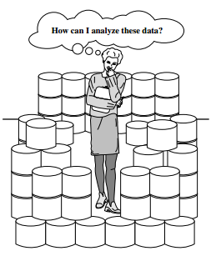
Query Processing VS Data Mining
Database Query:
Find all applicants with the name Bob.
Identify customers who returned items worth Rs. 10000 or more.
Data Mining
Find all applicants with high risk.
Identify customers with similar returning habits.

Slide 12
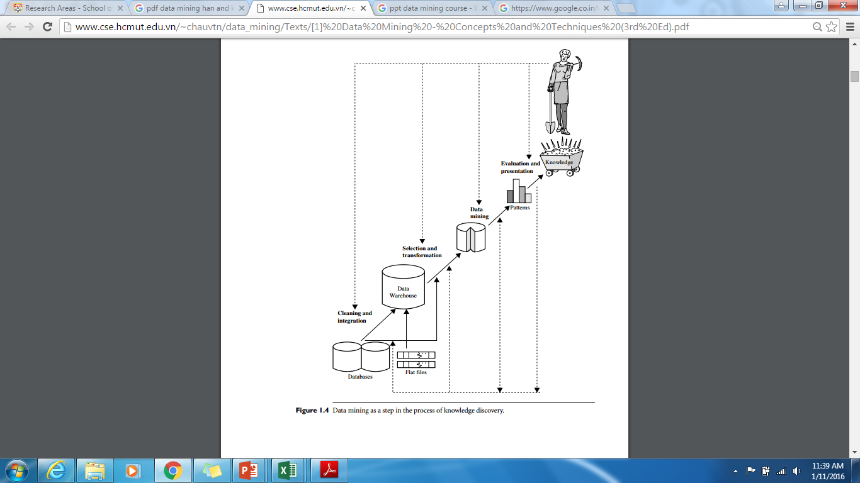

Slide 13
The knowledge discovery process as an iterative sequence of the following steps:
1. Data cleaning (to remove noise and inconsistent data)
2. Data integration (where multiple data sources may be combined)
3. Data selection (where data relevant to the analysis task are retrieved from the database)
4. Data transformation (where data are transformed and consolidated into forms appropriate for mining by performing summary or aggregation operations)
5. Data mining (an essential process where intelligent methods are applied to extract data patterns)
6. Pattern evaluation (to identify the truly interesting patterns representing knowledge based on interestingness measures)
7. Knowledge presentation (where visualization and knowledge representation techniques are used to present mined knowledge to users)

Slide 14
What kind of data can be mined?

Slide 15
Are all the patterns interesting?
To answer the first question, a pattern is interesting if it is
(1) easily understood by humans,
(2) valid on new or test data with some degree of certainty,
(3) potentially useful, and
(4) novel.
A pattern is also interesting if it validates a hypothesis that the user sought to confirm. An interesting pattern represents knowledge.

Slide 16
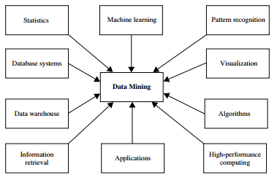
What technologies are used?

Slide 17
Challenges
Mining different kinds of knowledge in databases
Interactive mining of knowledge at multiple levels of abstraction
Incorporation of background knowledge
Data Mining query languages and ad-hoc data mining
Presentation and Visualization of data mining results
Handling noisy and incomplete data
Pattern evaluation
Handling of relational and complex types of data
Mining information from heterogeneous databases

Slide 18
References
Textbook:
“Data Mining: Concepts and Techniques” by Han and Kamber

